Slide 1
ABC Call Volume Trend Analysis
Presented By : Rahul Vishwakarma

Slide 2
Project Description
This report looks closely at incoming calls to ABC Insurance to help improve how quickly and efficiently customer calls are handled.
It starts by showing the average time spent on each call during different hours of the day, helping us understand when agents are busier or more efficient.
Next, we study the number of calls during each hour, using charts to clearly show when the call center gets the most calls.
Based on this, we suggest how many agents are needed each hour to reduce the number of missed or abandoned calls to just 10%.
We also address a major issue — no agents available at night — by creating a night shift plan so customers get help even after 9 PM.
All the assumptions, steps, and calculations used in this report are clearly explained.
In short, this report gives clear ideas to help manage the call center better and keep customers happier.

Slide 3
APPROACH:
In this project, we conducted a comprehensive analysis of 23 days of inbound call data for ABC Insurance, with the goal of improving
customer service and optimizing call center operations. The analysis began by cleaning and organizing the dataset into hourly time
buckets, allowing us to examine key metrics such as average call duration, total call volume, and call status (answered, abandoned, or
transferred) across different times of the day. This helped us identify peak call hours, periods of long wait times, and inefficiencies in call
handling. Based on these insights, we developed a manpower planning strategy to reduce the call abandon rate from 30% to 10%, by
calculating the minimum number of agents needed in each time slot. We also addressed the issue of night-time call handling, estimating
agent requirements for the 9 PM to 9 AM shift based on projected call volumes. Our approach takes into account agent availability,
working hours, and performance assumptions. The findings offer practical recommendations to help ABC Insurance enhance customer
experience, ensure timely response, and improve overall operational efficiency in their call center.

Slide 4
All the analysis has been performed in excel. This tool is also used to create graphical representation of the results and to understand the result set better.

Slide 5
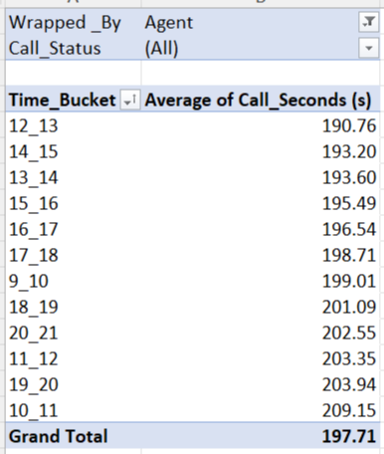
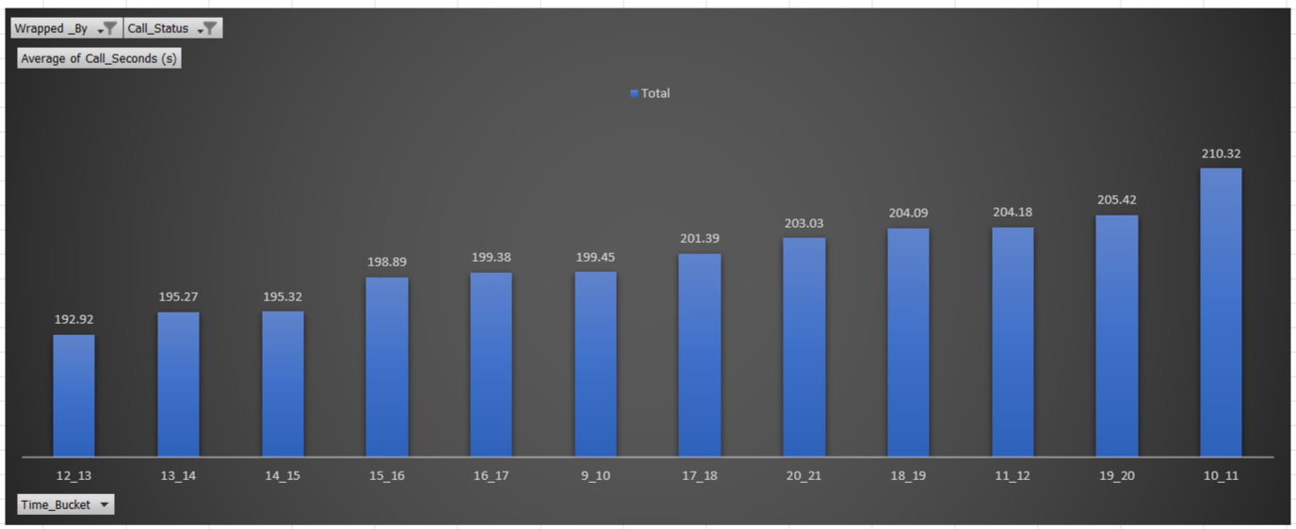
Average call duration: what is the average duration of calls for each time bucket?
The analysis of average call duration across different hourly time buckets revealed clear patterns in agent workload and customer interaction times. Time slots between 10AM-11AM showed the highest average call durations, indicating longer and possibly more complex customer conversations during this period. In contrast, early morning slots like 12PM-13PM showed shorter average durations, suggesting quicker resolutions or fewer detailed inquiries.
These findings suggest that agents may need additional support or expertise during mid-day hours to handle higher call complexity efficiently. Adjusting manpower or providing specialized training during these peak duration periods could lead to better call handling and reduced wait times.

Slide 6
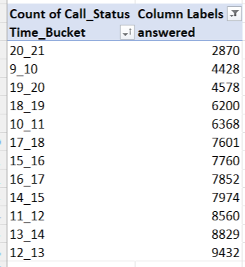
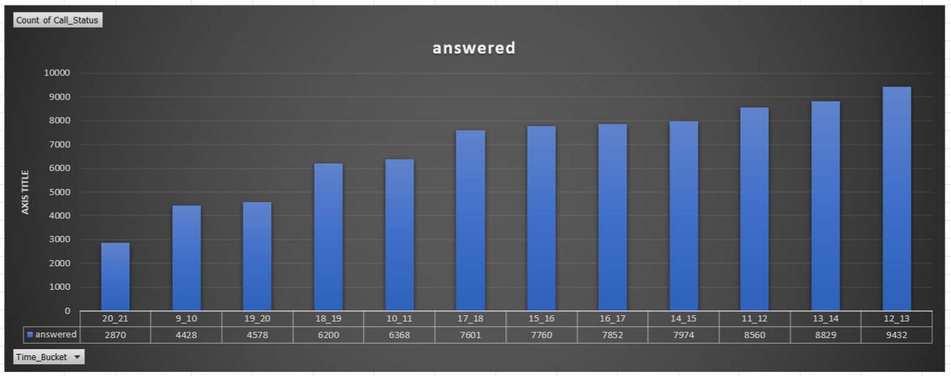
Call Volume Analysis: Can you create a chart or graph that shows the number of calls received in each time bucket?.
The highest call volumes occurred between 12 PM and 1 PM, indicating peak customer activity during mid-day hours. Early mornings and evenings had lower traffic. These patterns highlight the need for more agents during peak hours and fewer during quieter periods to optimize staffing and improve customer response time.

Slide 7
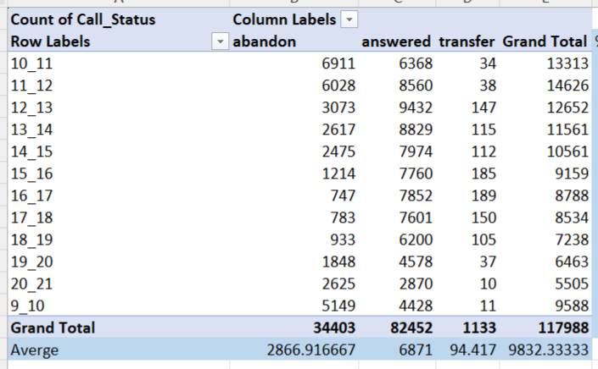
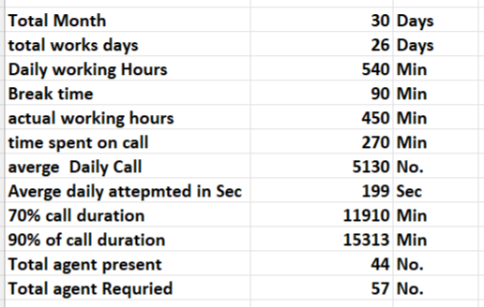
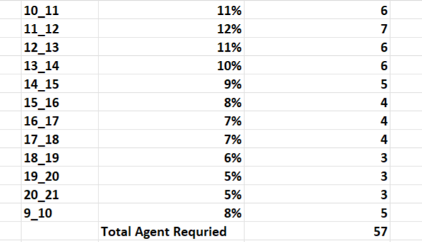
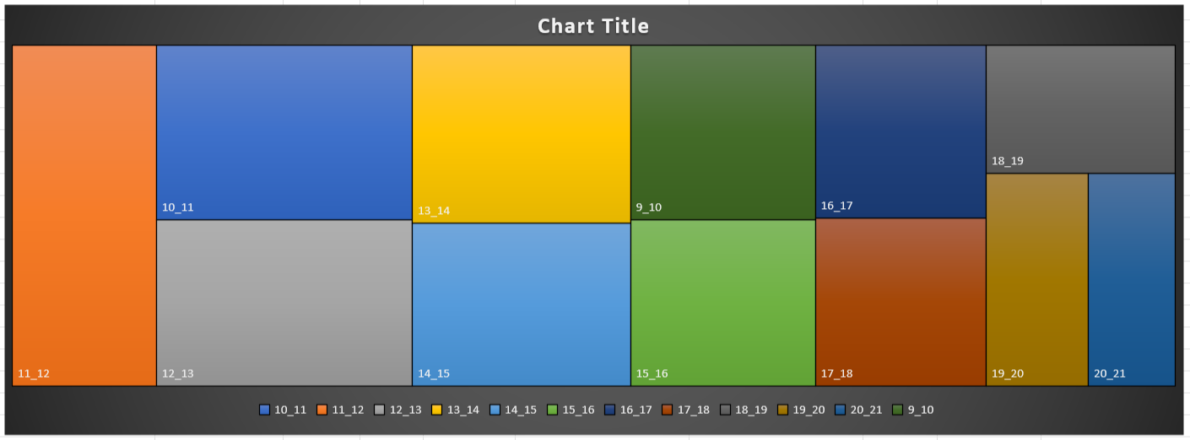
Manpower Planning: What is the minimum number of agents required in each time bucket to reduce the abandon rate to 10% ?
To reduce the call abandon rate from 30% to the target of 10%, a total of 57 agents are required across the day shift (9 AM to 9 PM). The required number of agents per hour is calculated based on actual call volume and average call duration in each time bucket. This Heat map size Represent number of agent required.

Slide 8
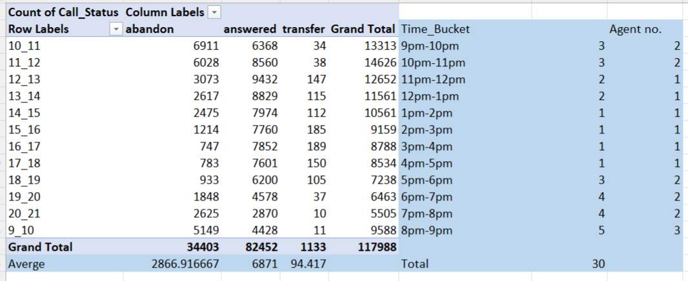
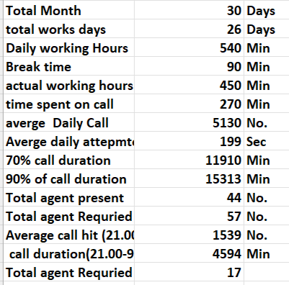
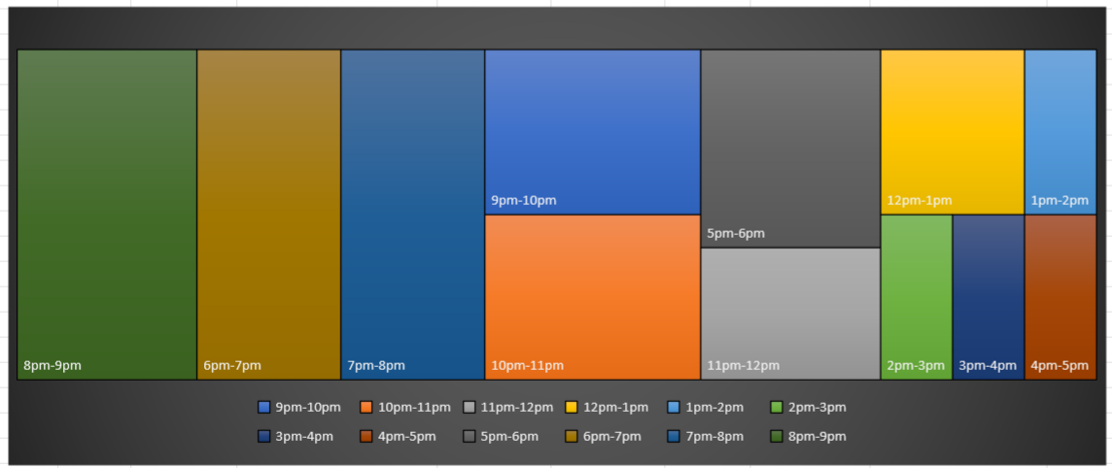
Night Shift Manpower Planning: Propose a manpower plan for each time bucket throughout the day, keeping the maximum abandon rate at 10%.
To ensure customer support is available 24/7 and maintain the maximum abandon rate at 10%, a night shift manpower plan has been proposed for the 9 PM to 9 AM window.
The total number of additional agents required is 17, distributed across each hourly time bucket based on projected call volume (assumed to be 30% of daytime calls).
The exact number of agents needed for each hour is shown in the "Agent no." column of the table. This plan ensures better customer experience during off-hours and helps reduce frustration caused by unanswered night-time calls.

Slide 9
This analysis provides a data-driven approach to improve call center efficiency and customer satisfaction at ABC Insurance. By examining call volume, average handling time, and agent capacity, we identified key peak hours and staffing gaps. A detailed manpower plan was proposed for both day and night shifts to reduce the abandon rate from 30% to the targeted 10%. Implementing these recommendations will help optimize resource allocation, ensure timely responses, and enhance overall customer experience. With proper execution, the call center can achieve better performance, reduced wait times, and stronger customer trust.
Conclusion

Slide 10
Thank You

